Slide 1

Rajiv Gandhi University of Knowledge Technologies,Basar Department of Computer Science & Engineering
Title: Home Made Foodies
Team Details:
R.RaviKumar(B210071) K.Naveen(B210581)
M.Rajendra Prasad(B211650)
Under the Guidance of: Devyani Mam

Slide 2
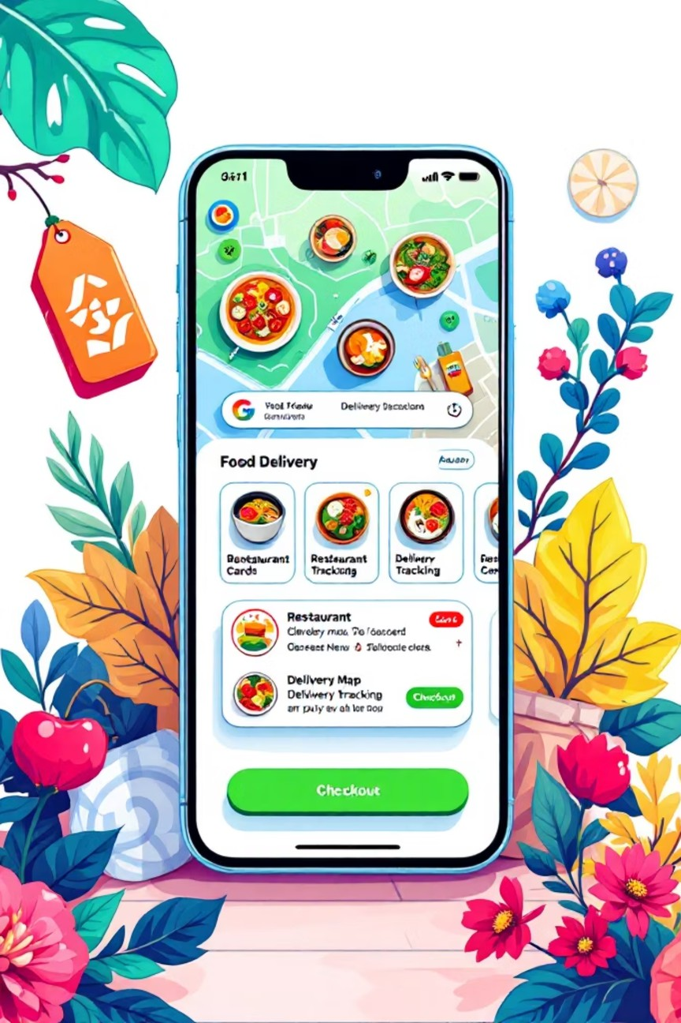
Platform Overview
HomeBite is a two-sided marketplace platform designed to bridge the gap between home-based food vendors and customers seeking authentic, locally-prepared meals.
Core Capabilities:
Vendors can list and manage their home-cooked food offerings with complete control
Customers can browse, search, and discover home-cooked meals in their locality
Secure payment processing with multiple payment method support Integrated delivery tracking with real-time status updates
Technical Stack: Mobile app built using React Native (Expo), Backend REST API using Node.js and Express.js, MySQL database managed with Prisma ORM. Platform supports three distinct user roles: Customer, Vendor, and Administrator.

Slide 3

Market Gap & Challenges
Current Market Limitations
Existing food delivery platforms like Zomato and Swiggy focus exclusively on registered restaurants, excluding the vast ecosystem of home-based food businesses. This creates a significant market gap.
Resulting Impact
The home-cooked food market remains largely unorganized, non-scalable, and inaccessible to mainstream customers
seeking authentic, home-prepared meals.
Key Issues:
Home-based vendors lack the digital infrastructure needed to grow their
businesses, while customers miss out on quality home-cooked food options.
No structured platform for home cooks to sell their food
Manual order management and cash-based transactions
Difficulty discovering authentic home-cooked meals nearby
No standardized ordering or delivery tracking system

Slide 4
Our Solution
HomeBite provides a structured digital marketplace specifically designed for home-based food businesses, addressing the key challenges faced by both vendors and customers.
Vendor Onboarding
Streamlined registration with admin approval workflow ensures quality control and platform integrity
Food Catalog
Complete menu management with pricing, dietary tags (Veg, Vegan, Jain), images, and descriptions
Cart System
Intelligent single-vendor constraint prevents order complexity and ensures smooth fulfillment
Secure Payments
Razorpay integration with HMAC signature verification for transaction security
Delivery Integration
Shiprocket API for shipment creation and real-time tracking capabilities
Reviews & Ratings
Post-delivery feedback system builds trust and quality assurance

Slide 5
Project Objectives
Primary Goals
Build a discoverable platform that connects home-cooked food vendors with customers seeking authentic, locally-prepared meals.
For Vendors:
Comprehensive menu and inventory management Streamlined order acceptance and processing Professional profile and business presence Secure payment collection and tracking
For Customers:
Intuitive browsing and discovery experience Seamless ordering with real-time tracking Flexible payment and delivery options
Technical Objectives
Implement JWT-based authentication with token rotation for enhanced security
Maintain data consistency using price snapshotting at order creation
Ensure secure and validated API interactions with request validation
Build modular, maintainable codebase with clear separation of concerns
Enable horizontal scaling through stateless backend architecture Integrate third-party services with proper error handling and fallbacks

Slide 6


Technology Stack
Backend Infrastructure
Node.js: Event-driven runtime for scalable server-side processing
Express.js: Lightweight framework for building RESTful APIs
Prisma ORM: Type-safe database access with automatic schema management
Frontend Development
React Native: Cross-platform mobile application framework
Expo SDK: Development tools and deployment pipeline
Zustand: State management for global application state
Axios: HTTP client for API communication with the backend
MySQL 8.0: Relational database for structured data storage
External Integrations
Razorpay: Payment processing with multiple payment methods and secure verification
Shiprocket: Delivery and tracking system with real-time shipment updates
HTTPS APIs: Secure communication layer with encrypted data transmission

Slide 7
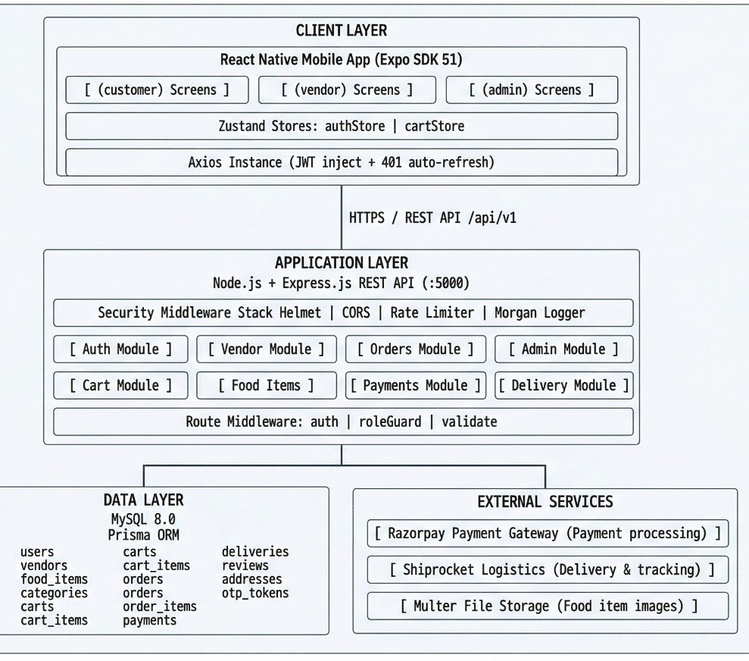

System Architecture
HomeBite follows a three-tier architecture design, ensuring separation of concerns, maintainability, and scalability.
Presentation Layer
React Native mobile application providing role-based navigation for Customers, Vendors, and Administrators. Clean UI/UX design focused on usability.
Application Layer
Node.js + Express REST API with comprehensive middleware stack: JWT authentication, role-based access control, and request validation using Joi schema validation.
Data Layer
MySQL database managed using Prisma ORM with type-safe queries and automatic schema synchronization. Backend maintains stateless architecture enabling horizontal scaling.

Slide 8





Core Modules
Authentication
User registration, login, and JWT token management with refresh token rotation
Vendor
Vendor registration with admin approval, profile and menu management dashboard
Food
Food item creation with pricing, images, descriptions, and dietary classification tags
Cart
Single cart per user with enforced single-vendor restriction to simplify ordering
Order
Complete order lifecycle management with status transitions from pending to delivered
Payment
Razorpay integration with order creation, payment verification using HMAC signatures
Delivery
Shiprocket API integration for shipment creation and real-time tracking capabilities
Admin
Vendor approval workflows, platform monitoring, and comprehensive analytics dashboard

Slide 9

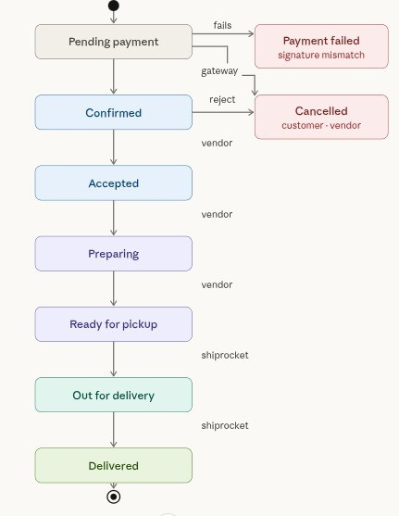
Order Processing Flow
The order lifecycle ensures complete tracking and data consistency from cart addition to final delivery.
Cart Addition
Customer adds items to cart with single-vendor constraint enforced automatically
Order Creation
Order created with PENDING_PAYMENT status and price snapshot stored
Payment Initiation
Razorpay checkout launched and payment processed securely
Verification
HMAC signature verification ensures payment authenticity
Confirmation
Order status updated to CONFIRMED and vendor notified
Acceptance
Vendor accepts order and status transitions to ACCEPTED
Preparation
Food prepared and status updated to PREPARING and READY_FOR_PICKUP
Delivery
Shiprocket creates shipment and tracks until DELIVERED status

Slide 10
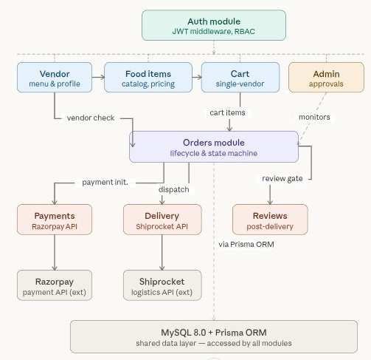

Slide 11
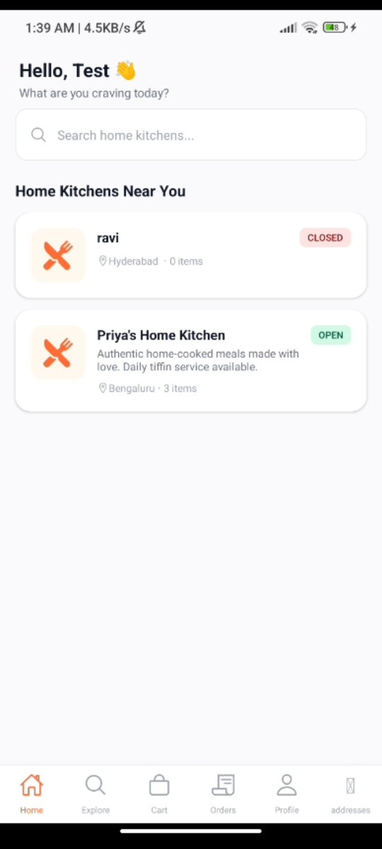
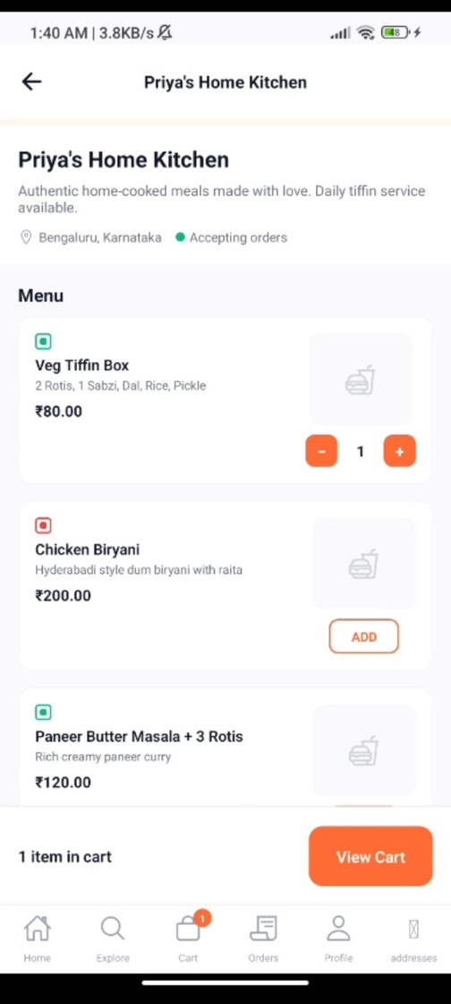
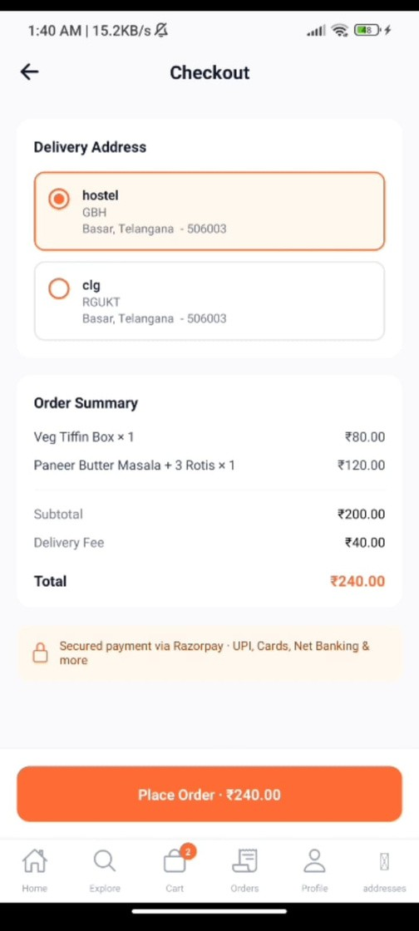
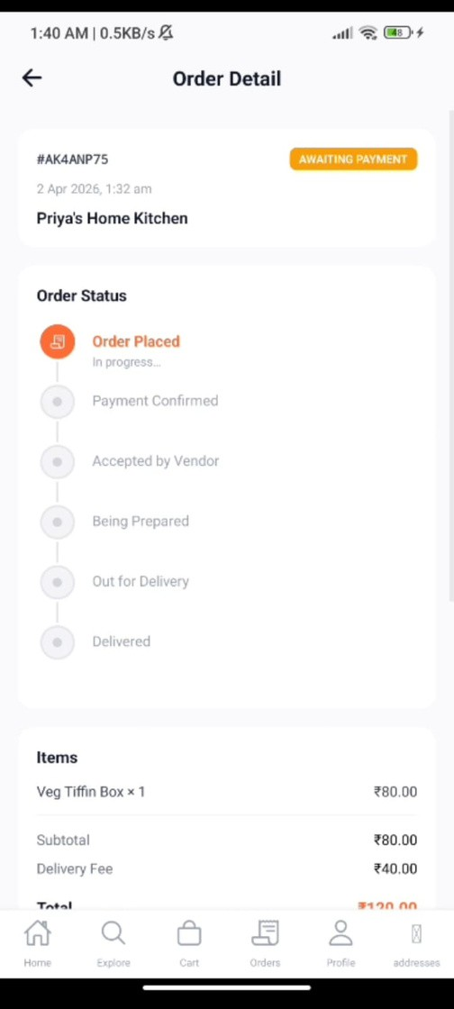
Customer

Slide 12
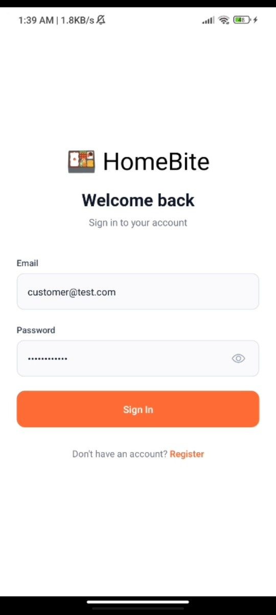
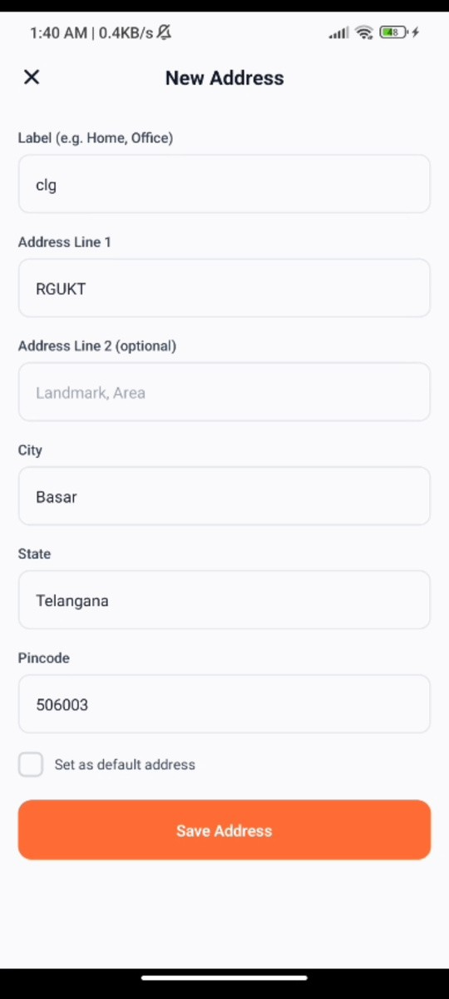
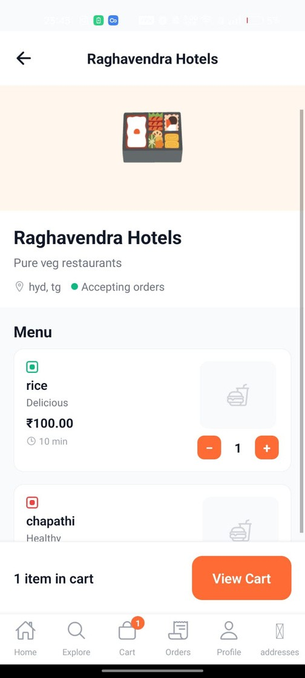
Vendor

Slide 13
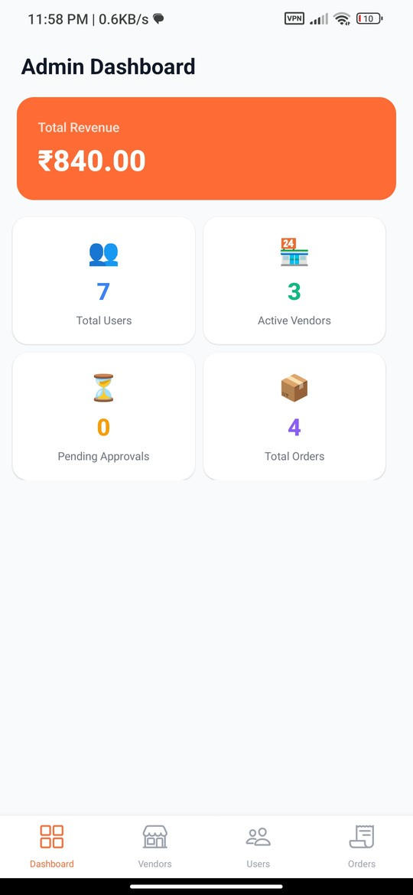
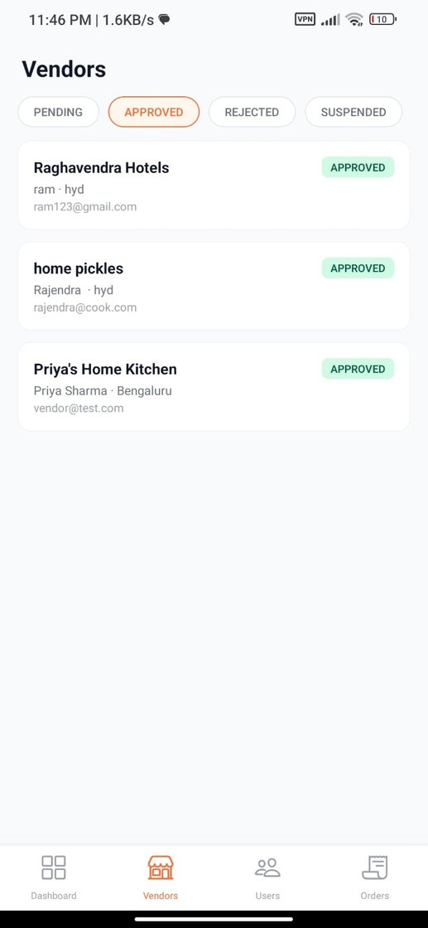
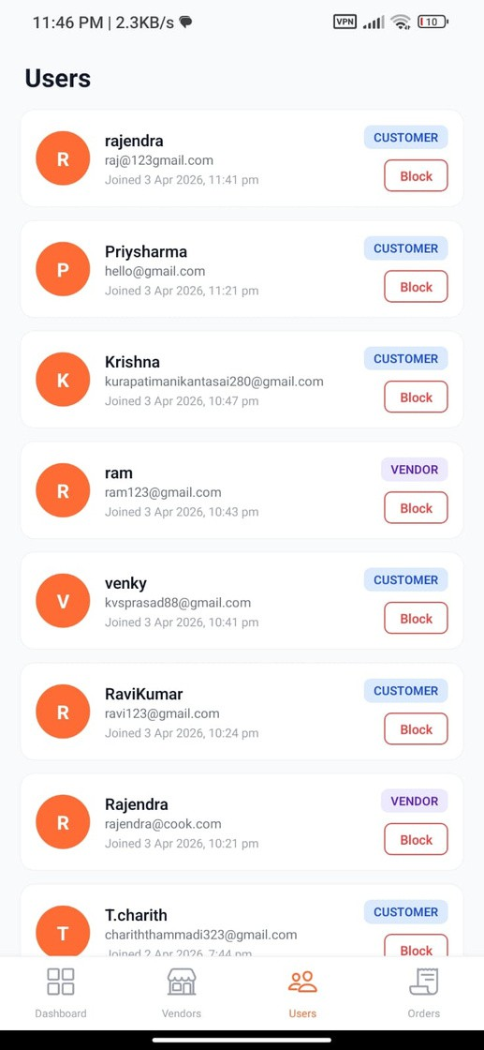
Admin

Slide 14

Conclusion & Future Vision
HomeBite successfully addresses a real-world gap in the food delivery ecosystem, providing a structured marketplace for home-based food businesses while delivering reliable, transparent experiences for customers.
Future Enhancements
Platform designed for extensibility with planned features:
Location-based filtering and discovery
Real-time notifications using WebSockets
AI-based personalized recommendations Multi-vendor cart with intelligent routing
Subscription meal plans and recurring orders
Key Strengths
Modular backend architecture with clear separation of concerns
Secure JWT-based authentication with token rotation
Integrated payment and delivery systems with proper error handling
Data integrity maintained through price snapshotting
Stateless backend enabling horizontal scaling

